Slide 1


A lightweight wellness journaling mobile application

Slide 2
LyfeLog Tech Stack
Framework — React Native with Expo
Navigation — Expo Router Navigation
Backend (Authentication, Database) — Appwrite
Audio — Expo AV

Slide 3
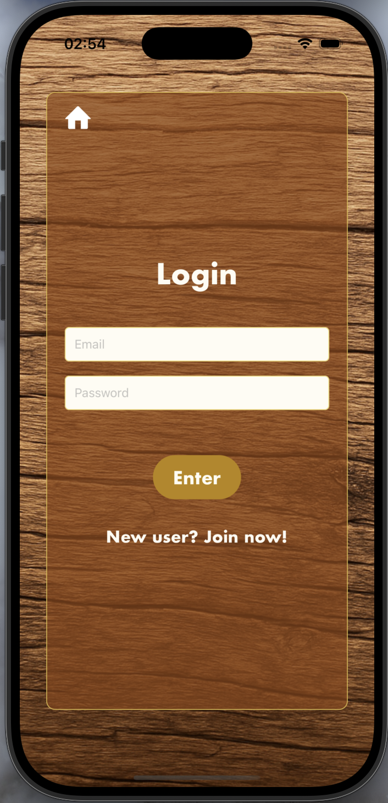

LyfeLog Features
User Authentication
Optional Immersive Audio

Slide 4
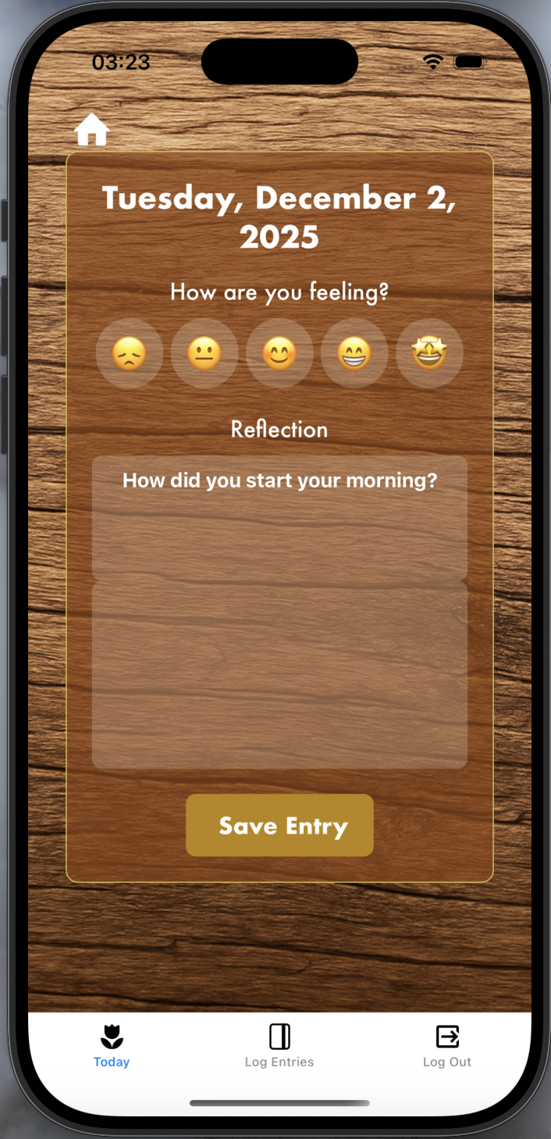
LyfeLog Features
Daily journaling with AI generated reflection prompts
Mood logging
UI tabs for quick and easy navigation

Slide 5
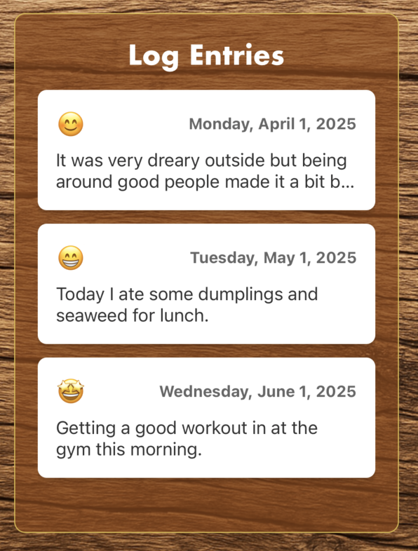
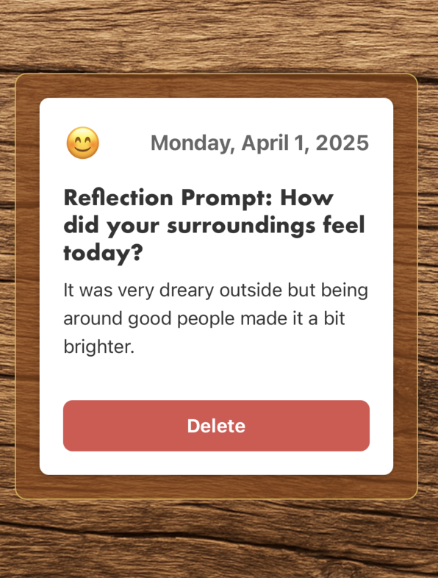
LyfeLog Features
Log entry history

Slide 6
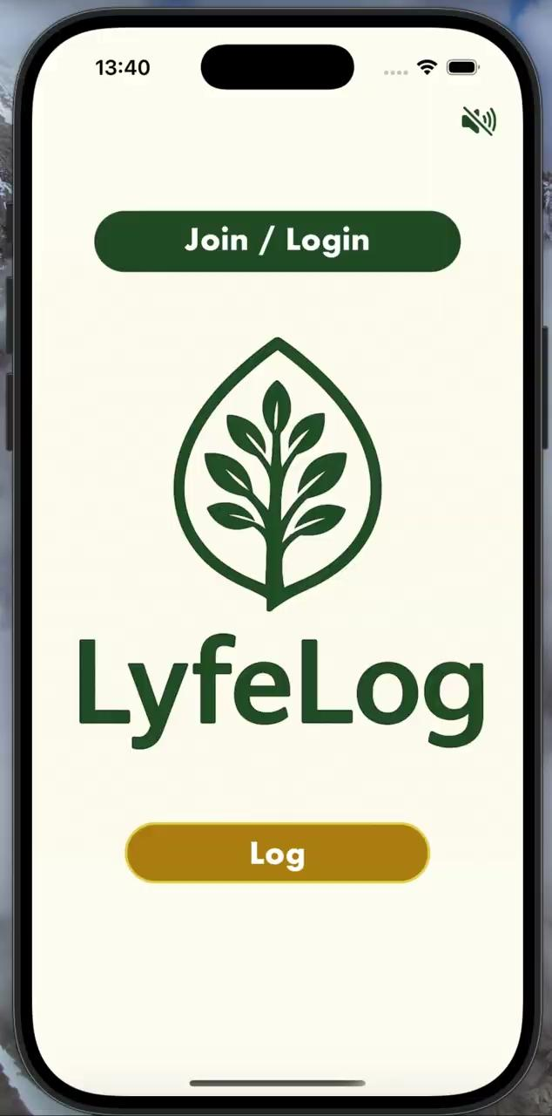
User Flow Demo

Slide 7
Questions??

